Slide 1
NUMBER SYSTEM
Trailing zeros
Unit digit
Divisibility
No of divisors
Applications of Number System
Remainders & its Application
HCF & LCM

Slide 2
Trailing Zeros
Find the number of trailing zeros in 24!, 95!, 142!
Find the number of trailing zeros in 24*40*200*48*25
Find the number of trailing zeros in 42*21*125*20*80*100*16*55

Slide 4
The digit in the unit’s place in the expansion of
(123 ×456×789) is?
1] 2 2] 3 3] 6 4] 9
2. What is the last digit of the expression777777?
1] 3 2] 1 3] 7 4] 9
3. The digit in the unit’s place, if 1212 is multiplied by 1313 is?
1] 6 2] 8 3] 2 4] 4
4. The unit’s digit of the expression 111+122+133+⋯+166 is?
1] 9 2] 7 3] 1 4] 0
5. The unit’s digit of the product 31001×722002×
13333003 is?
1] 1 2] 3 3] 5 4] 9

Slide 5
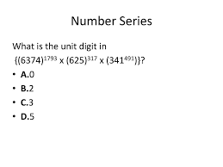
Unit digit power cycle

Slide 6
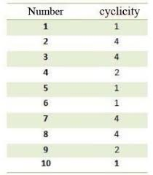
Cyclicity chart:

Slide 7
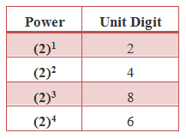
Unit digit : 2

Slide 8
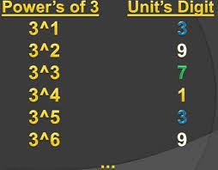
Unit digit : 3

Slide 9
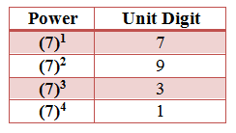
Unit digit : 7

Slide 10
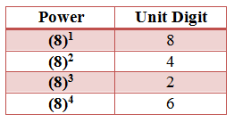
Unit digit : 8

Slide 11
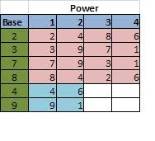
Summary

Slide 12
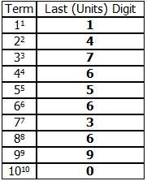

Slide 13
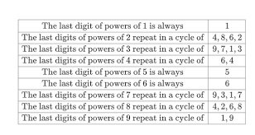

Slide 14
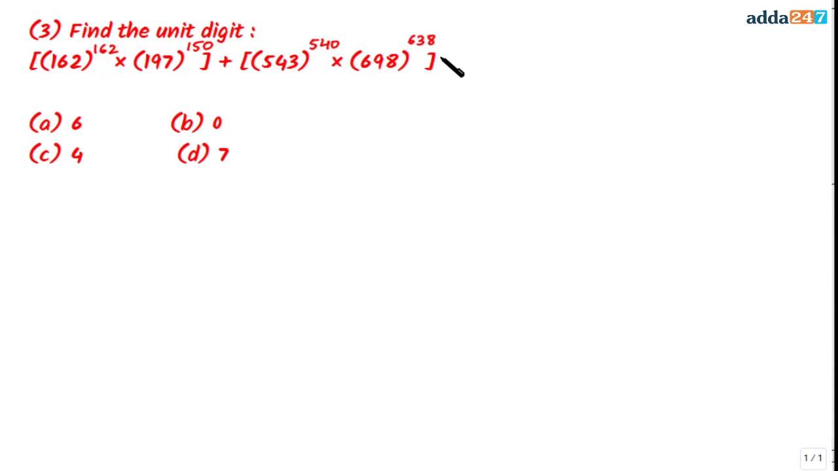

Slide 18
DIVISIBILITY
Q. Which one of the following numbers is divisible by 8 and 11 simultaneously?
1] 12496 2] 414206 3] 999000 4] 38400
Q. Which one of the following numbers is divisible by 7 and 9 simultaneously?
1] 803619 2] 203861 3] 552951 4] 339927
Q. If 517*324 is divisible by 3, what will be the smallest digit in place of *
1] 0 2] 1 3] 2 4] 3
Q. What least value must be given to * so that the number 97215*6 is divisible by 11
1] 3 2] 2 3] 1 4] 5

Slide 19
No of Divisors
Find no of divisors of
144
600
3600
37800
1000

Slide 20
How many factors of the number 2⁸ * 3⁶ * 5⁴ * 10⁵ are multiples of 120?
540
660
594
792

Slide 21
How many factors of 2⁴ * 5³ * 7⁴ are odd numbers?
100
99
20
24

Slide 22
How many factors of 2⁵ * 3⁶ * 5² are perfect squares?
18
24
36
8

Slide 23
How many factors of 1080 are perfect squares?
4
6
8
5

Slide 24
Number N = 2⁶ * 5⁵ * 7⁶ * 10⁷; how many factors of N are even numbers?
1183
1200
1050
540

Slide 25
Remainders & its Application
A number which when divided by 32 leaves a remainder of 29. If this number is divided by 8, what will be the remainder ?
A number which when divided by 342 leaves a remainder of 47. If this number is divided by 18, what will be the remainder ?
A number which when divided by 5 leaves a remainder of 3. If the square of the number is divided by 5, what will be the remainder ?

Slide 27
HCF & LCM
FRACTIONS
PRODUCT OF 2 NUMBERS
APPLICATIONS OF LCM
HCF WITH REMAINDER
LCM WITH REMAINDER

Slide 28
HCF & LCM
Let a:b = 4:5 and LCM of a and b is 60, then the smaller number would be:
(1) 12 (2) 20 (3) 16 (4) 30
HCF of 3/5 and 12/13 is
(1) 3/65 (2) 3/130 (3) 3/5 (4) 3/13
LCM of 2/3, 4/6, 8/27
(1) 2/27 (2) 8/3 (3) 2/3 (4) 8/27
Find the HCF of 2.1, 1.05 and 0.63
(1) 0.44 (2) 0.64 (3) 0.21 (4) None of these
If LCM of two number is 693, HCF of two numbers is 11 and one number is 99, then find other
(1) 34 (2) 77 (3) 12 (4) 45
The ratio of two numbers is 3 : 4 and their H.C.F. is 4. Their L.C.M. is
(1) 48 (2) 22 (3)46 (4) 27

Slide 30
Applications of HCF & LCM
The traffic signals at four road crossings change every 30 seconds, 1 minute, 45 seconds and 75 seconds. If they changed together at 09:00 am, at what time will they change again ?
Five bells commence tolling together and toll at intervals of 2, 5, 6, 8 and 9 seconds. How many times do they toll together in an hour?
An electronic device makes a beep after every 60 seconds. Another device makes a beep after every 62 seconds. They beeped together at 10 am, at what time will they beep together next ?

Slide 32
Remainder Applications
Find the greatest number that will divide 82, 111 and 140 leaving the same remainder in each case.
What is the largest number which when divided by 10, 13 and 21 leaves 5 as the remainder in each case?
Find the smallest number which when divided by 20, 25, 35, 40 leaves remainder 6
Find the greatest number that will divide 60 and 98 leaving remainder 3 in each case.
Find the largest number that will divide 37 and 58 leaving remainders 2 and 3 in each case.
Find the smallest number which when divided by 16, 24, 30 leaves remainder 6, 14, 20 in each case.

